Slide 1
Effect of viewing distance on object responses in macaque areas 45B, F5a and F5p
Capara I^{1,2} and Janssen P^{1,2}, bioRxiv pre-print
¹Laboratorium voor Neuro-en Psychofysiologie, Katholieke Universiteit Leuven
²The Leuven Brain Institute
Presented by: James Goodman
Neurobiology Journal Club
30.06.2020
Notes:
For journal club I was weighing “relevance” against “exciting”
I went for a pre-print satisfying the “relevance” criterion, from a lab looking into very similar questions as our own. I ended up being disappointed by this one though.
Fair warning too: it’s pretty old-school
But, in considering what I want to study on related topics from this lab, I must “know my enemy” and know what topics are receiving recent experimental attention (and how solid they are)
The “exciting” paper I had considered was a nature comms paper about the retinal origins of saccadic suppression from Ziad Hafed’s lab in Tübingen

Slide 2
Introduction to peri- and extra-personal space
Image credit: Van der Stoep et al. 2014 Neuropsychologia
Notes:
This paper is primarily about the neuronal processing of objects presented within peri- and extra-personal space.
These are terms with importance in the study of the psychophysics of grasping, and essentially can be taken to mean “within reach” and “out of reach”.
Obviously, an object presented within reach offers more grasping affordances than one presented out of reach, and so one might reasonably expect a qualitative difference in how objects within and out of reach are represented in visuomotor cortical grasping circuits.

Slide 3
Anatomically distinct preferences for peri- and extra-personal space
Cléry et al. 2018 NeuroImage
Notes:
Indeed, previous research (admittedly from this same group) has suggested an anatomical difference in how within- and out-of-reach objects are represented.
Specifically, entirely different cortical areas seem to be involved in the processing of peri- and extra-personal space.
(then explain the fMRI experiment you choose to highlight)

Slide 4
Anatomically distinct preferences for peri- and extra-personal space
Cléry et al. 2018 NeuroImage
Notes:
Indeed, previous research (admittedly from this same group) has suggested an anatomical difference in how within- and out-of-reach objects are represented.
Specifically, entirely different cortical areas seem to be involved in the processing of peri- and extra-personal space.
(then explain the fMRI experiment you choose to highlight)
mainly, we see that they find a frontal preference for peripersonal space and a parietal preference for extrapersonal space

Slide 5
“Mirror” neurons show a mixed distribution of preferences
Caggiano et al. 2009 Science
Notes:
The reason this topic is relevant for me (and the lab in general) is that they are thought to be an important factor in determining whether putative “Mirror” neurons respond to a presented object.
Among these putative mirror neurons, however, is a distribution of preferences for peri- and extra-personal space. One which doesn’t reflect the fMRI result suggesting a preference for peri-personal space in a lumped definition of premotor areas.
(Describe the Science paper here).
Note: panel C describes VISUAL trials.
(this paper also looks at near-but-blocked vs. far as similar measures of “outside of peripersonal space” and found some evidence to support that notion)

Slide 6
A gradient within frontal areas?
Notes:
Peter Janssen, master “splitter” that he is, is looking throughout the frontal cortical areas to see if, for instance, the mixed preferences of putative mirror neurons in F5 may indeed reflect an anatomical gradient within frontal cortex.
Shown here is a schematic from a poster illustrating the Janssen proposed hierarchy that they’re working with in this paper.
F5: anterior and posterior subdivisions, which Peter Janssen believes are functionally distinct areas, with anterior being more “vision”-like and F5p being more “motor”-like
Area 45B: A strange area to be sure, which may or may not be homologous to human Area 45 (i.e., Broca’s area, i.e., the motor control of vocalizations and speech), but which seems in macaques to be primarily related to visuomotor grasping (and admittedly, it seems that speech processing is unilateral in humans, raising the question of what the other hemisphere might be doing with that cortical real estate)
This paper seems to be part of Irene Caprara’s overarching thesis project about area 45B in particular. They have a 2018 fMRI + ephys paper about visual responses in area 45B.
(Image credit: Caprara, Stockem, and Janssen 2018 Effect of viewing distance on object responses in macaque areas 45b and F5 Neuroscience 2018 poster)

Slide 7
Putative conclusions
Rostro-caudal gradient of near-far selectivity
Rostro-caudal visuo-motor gradient
The caudal “Motor”-like areas have stronger “far” selectivity
The rostral “Visual”-like areas have stronger “near” selectivity
Notes:
I’m going to present the conclusions they make first, THEN discuss the methods & analyses that brought them here. Just like a math or logic paper would do it.
Spoiler, though: these conclusions are filtered through my own interpretations! And I really did not like the paper!
Contrary to the most common piece of advice about scientific communication, we’re not actually here to tell a story, we’re here to critically assess scientific claims. And putting the conclusions up front helps guide our ability to critically assess what’s going on.

Slide 8
Putative conclusions
Rostro-caudal gradient of near-far selectivity
Rostro-caudal visuo-motor gradient
The caudal “Motor”-like areas have stronger “far” selectivity
The rostral “Visual”-like areas have stronger “near” selectivity
???
Notes:
I’m going to present the conclusions they make first, THEN discuss the methods & analyses that brought them here. Just like a math or logic paper would do it.
Spoiler, though: these conclusions are filtered through my own interpretations! And I really did not like the paper!
Contrary to the most common piece of advice about scientific communication, we’re not actually here to tell a story, we’re here to critically assess scientific claims. And putting the conclusions up front helps guide our ability to critically assess what’s going on.

Slide 9
Chamber placement and electrode locations
Notes:
2 monkeys, only 1 of them is being shown here
They accessed all 3 areas from the same chamber in each monkey. Using standard old-school tungsten glass-insulated single-contact electrodes.
They show these MRIs to show that the positioning of their electrodes was indeed appropriate to reach the areas they were targeting.

Slide 10
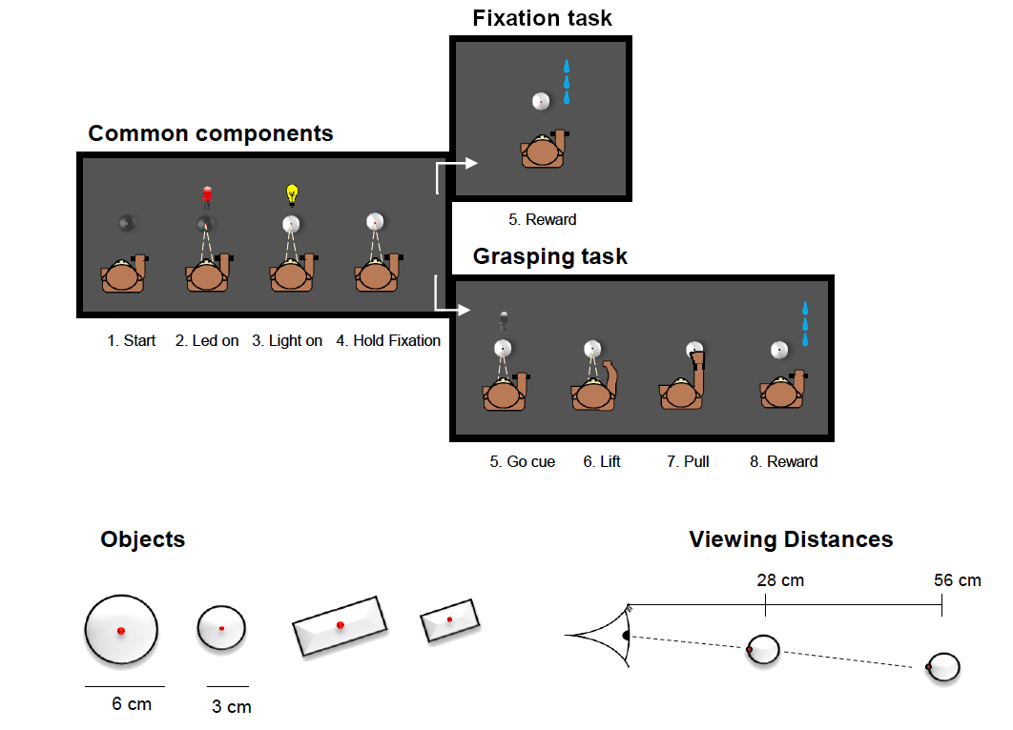
Task
Notes:
Objects presented to animal at the two distances from the monkey using a robot

Slide 11
Task
Notes:
Objects presented to animal at the two distances from the monkey using a robot

Slide 12
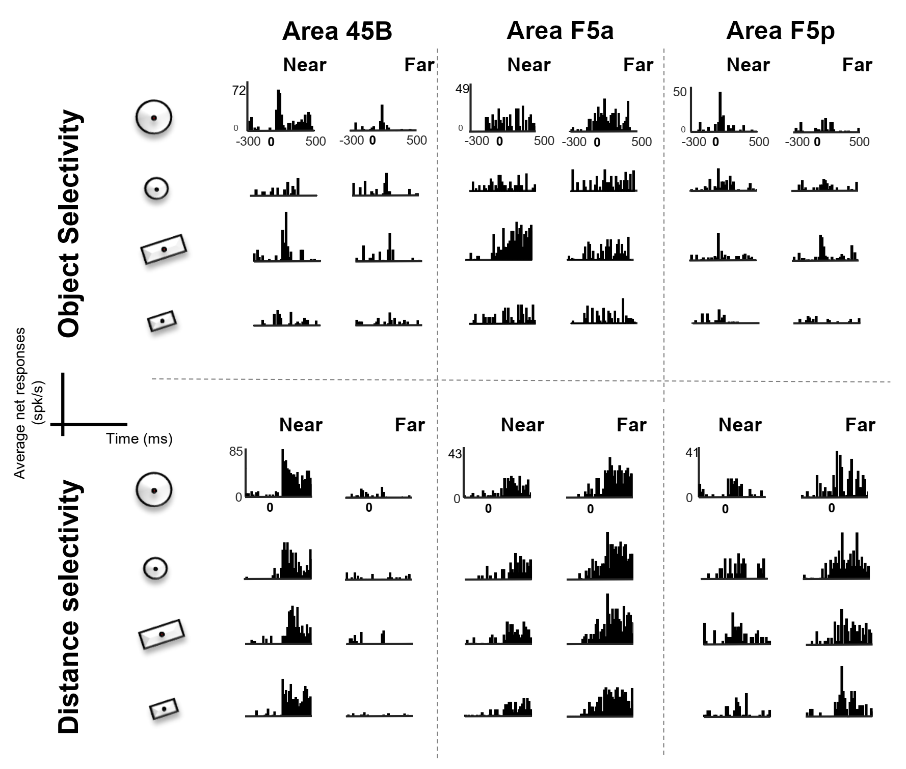
Example PSTHs during fixation task
Notes:
Zero is relative to illumination on
here, they’re trying to illustrate the typical neuron from:
Area 45B: transiently active, strongly object-selective, tends to prefer near to far
Area F5a: slower activity dynamics, weakly object-selective, far-to-near preference is weaker
Area F5p: transiently active, weakly object-selective, (“intermediate” 45B and F5a in many respects), tends to slightly prefer far over near
Of course, litigating the examples in these PSTHs suggests that you simply have a mixture in both F5a and F5p.

Slide 13
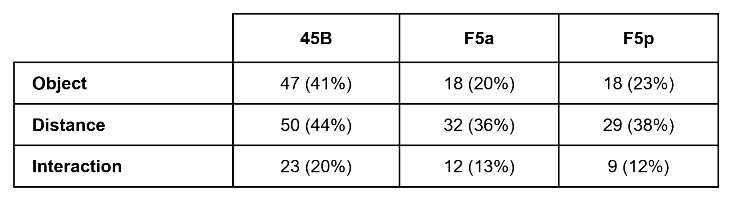
Similar proportions of neurons with distance preferences across areas
Notes:
45B (N = 114), F5a (N = 89) and F5p (N = 77)
Numbers for each monkey, in order of 45B / F5a / F5p:
Monkey 1: 57 / 45 / 44
Monkey 2: 57 / 44 / 33
These are all based on significant terms in each neuron’s ANOVA (alpha = ???)

Slide 14
More object selectivity in area 45B relative to area F5
Notes:
45B (N = 114), F5a (N = 89) and F5p (N = 77)
Numbers for each monkey, in order of 45B / F5a / F5p:
Monkey 1: 57 / 45 / 44
Monkey 2: 57 / 44 / 33
These are all based on significant terms in each neuron’s ANOVA (alpha = ???)

Slide 15
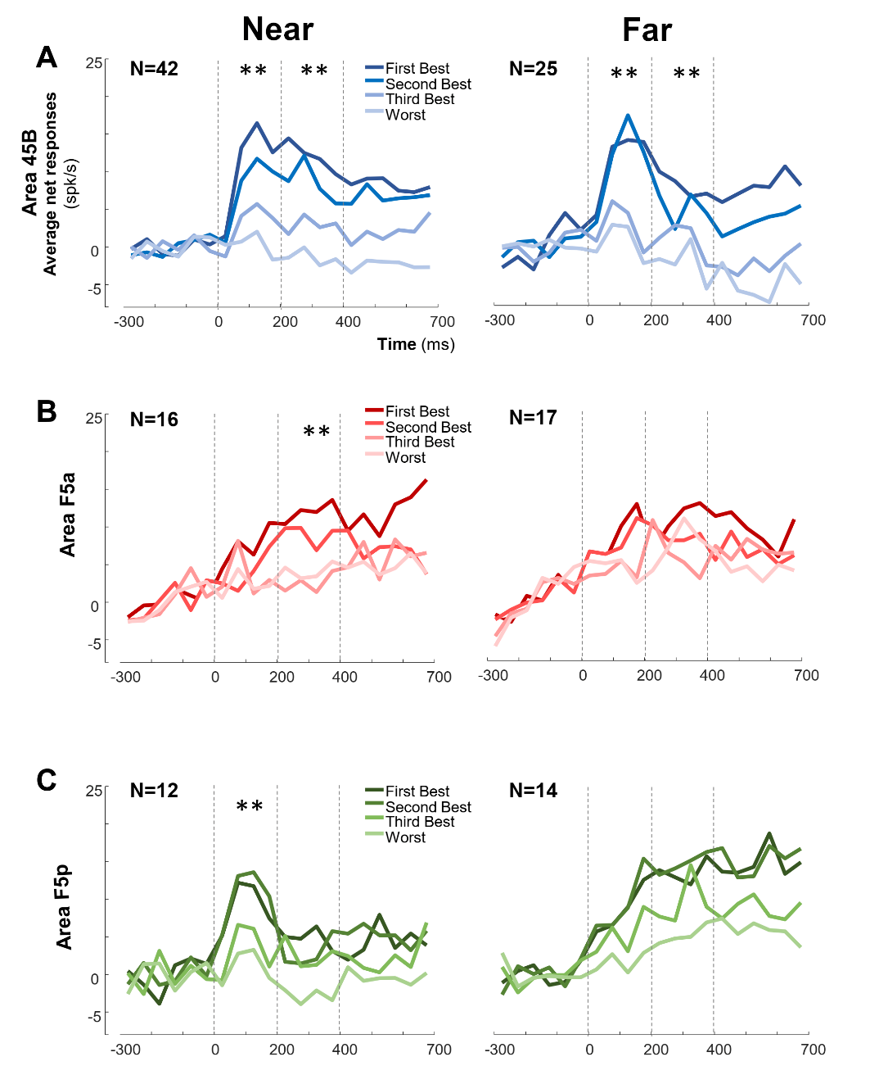
Population-averaged responses reflect gradients of object preference
Notes:
Old-school population analyses: just average all the PETHs together
Time is relative to illumination on
Vertical lines are arbitrary “early” and “late” epoch markers
Averages are taken ACROSS monkeys
Numbers for each monkey, in order of 45B / F5a / F5p:
Monkey 1: 57 / 45 / 44
Monkey 2: 57 / 44 / 33
Plotted here are only the OBJECT-SELECTIVE neurons, hence the smaller numbers
Basically, 45B was more selective to object in both the near AND far conditon than either subdivision of F5
Both F5 subdivisions have poor object selectivity in the Far condition
F5a is selective in the near condition in the “late” epoch
F5p is selective in the near condition during the “early” epoch
Strange sequence, given previous reports of F5a being the “visual” one and F5p being the “motor” one.
By the way: yeah, no error bars. Get used to that.
(Note, too, that this is all during PASSIVE observation)

Slide 16
Comparing near vs. far responses reveals (?) rostrocaudal gradient of distance preference
Notes:
This table’s documentation is pretty weak, but it’s the main source of their claim for a rostro-caudal gradient.
What I *think* is going on:
they find the neuron’s preferred object x distance combination
They note which distance and which size of object the object’s preference
They ignore significance and only look for whether the mean response magnitude was indeed larger, hence why 100% of neurons seem to exhibit a preference here
Anyway the bottom row is all they really talk about. It’s very confusing though, and everything up to this point suggests that all 3 areas prefer near over far, just that F5 has a mix and 45B strongly prefers near-presented objects. Which still goes against the established rostro-caudal gradient one would expect.
(note that area 45B receives input from posterior AIP. So area F5 isn’t the first node where posterior parietal input first arrives).
Anyway, this is the only piece of evidence that supports that conclusion and it’s pretty weak. Seems like something that ought to be scrapped when it moves out of the preprint phase.

Slide 17
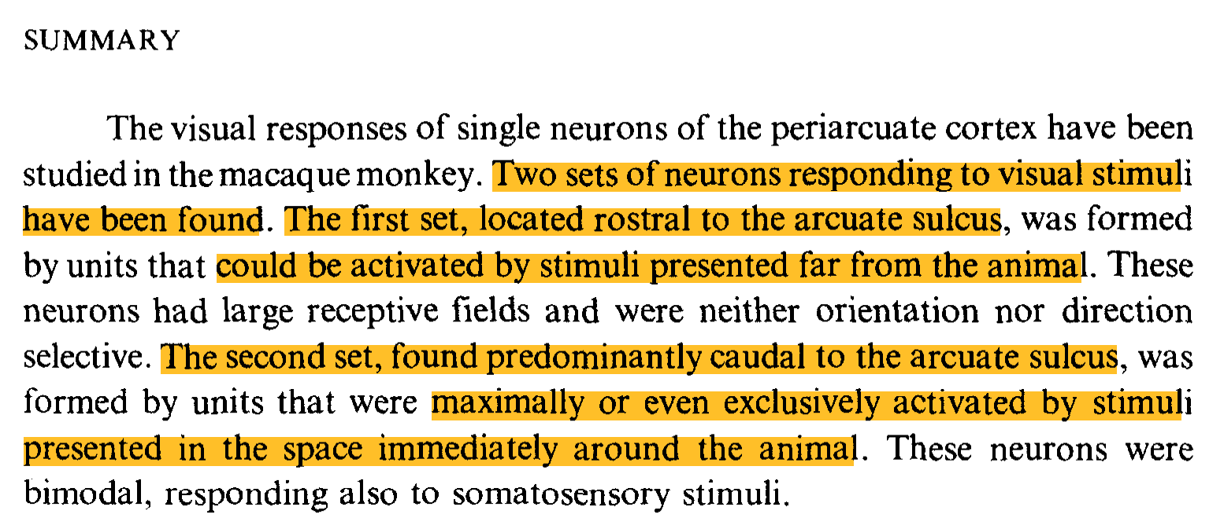
Gradient inconsistent with previous literature!
Rizzolatti et al. 1981 Behav. Brain Res.
Notes:
Rizzolatti et al 1981 looked at this exact thing and found the exact opposite: (find a figure from THAT paper)
rostral areas preferred extra-personal space
caudal areas preferred peri-personal space
By the way they don’t cite that paper…
...although one should be wary of this, as it’s all *quite* qualitative (if thorough)

Slide 18
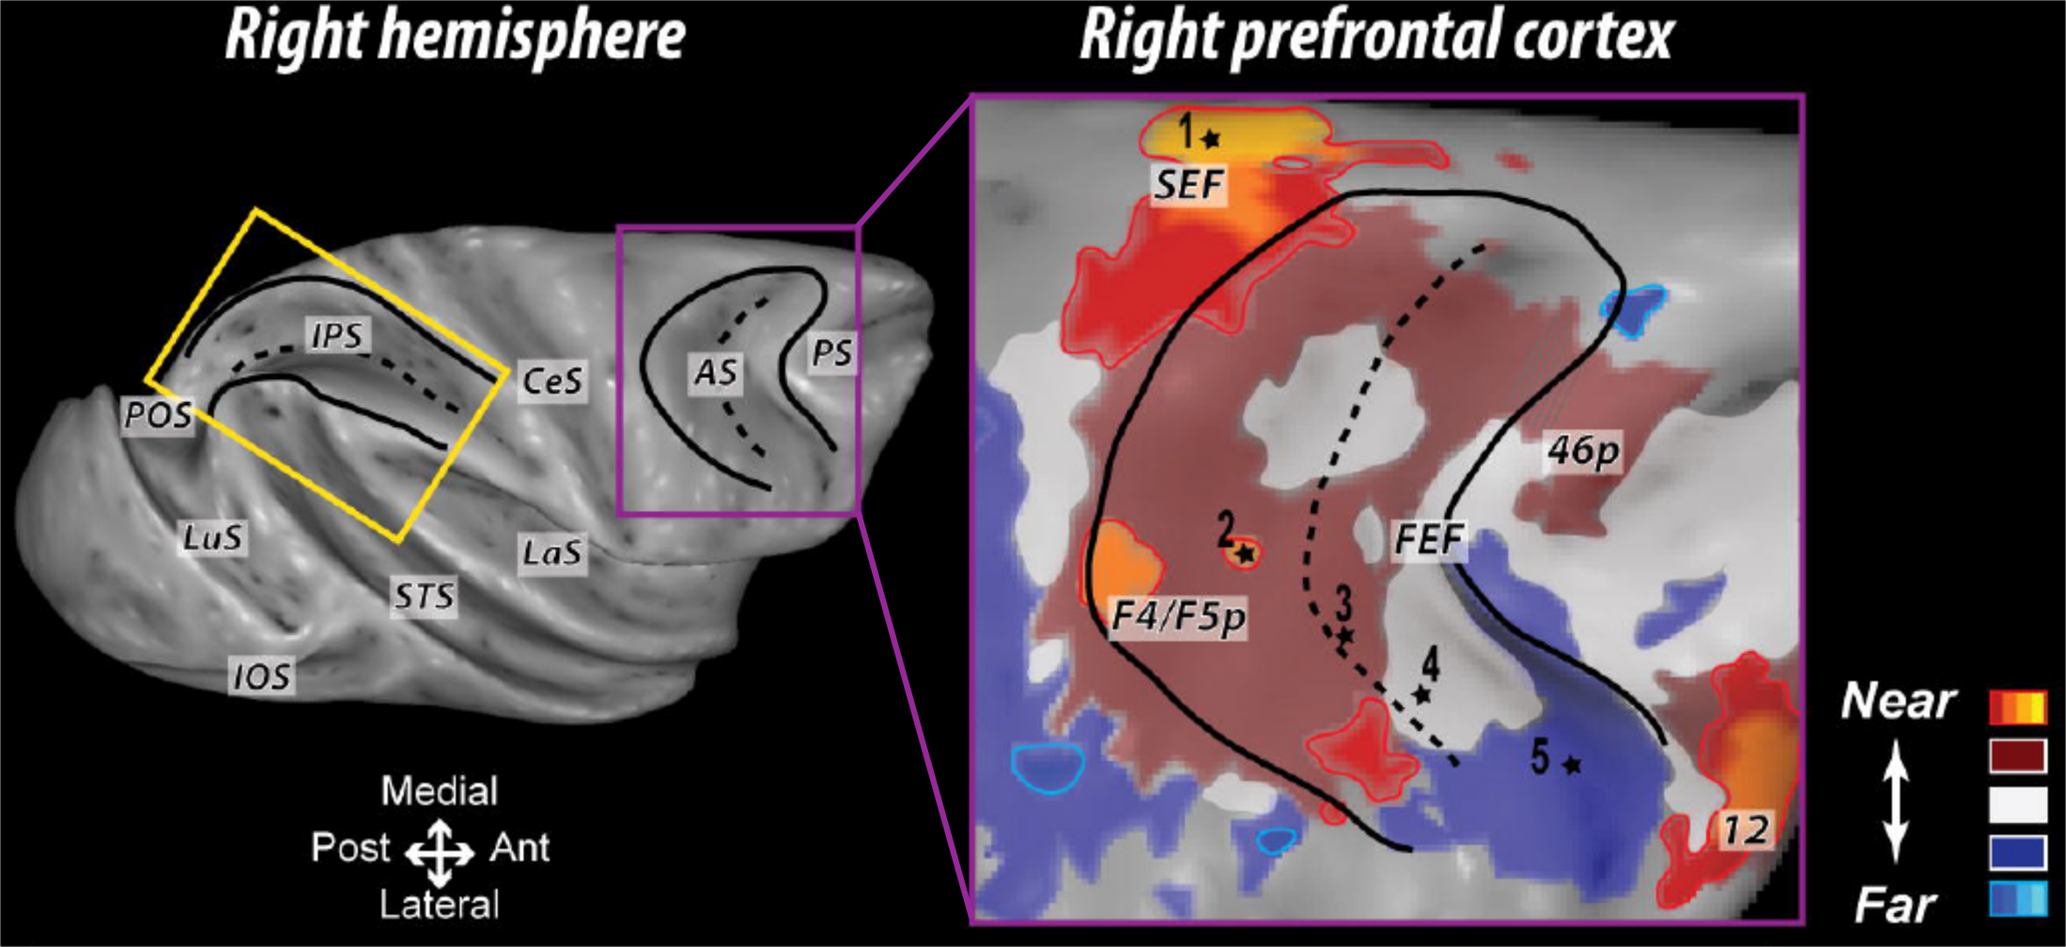
Gradient inconsistent with previous literature!
Cléry et al. 2018 NeuroImage
Notes:
…but they do cite that fMRI paper I mentioned earlier, which suggests an orthogonal medio-lateral gradient within frontal areas (which, if anything, runs from caudal to rostral, still opposite this paper’s main result)
what on earth is going on here?

Slide 19
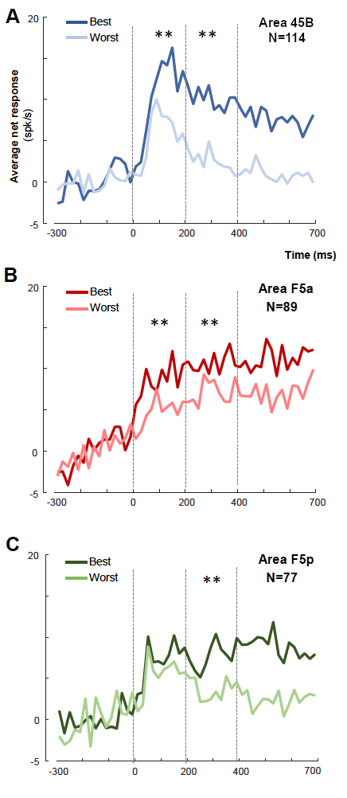
Typical distance selectivity is weak in F5, strong in 45B
Notes:
These are DEFINITELY matched to each neuron’s preferred object x distance combo, with the “worst” plot being the same object at the non-preferred distance
We see a larger effect in 45B than in either F5 subregion, although there are significant effects across all areas (including “late” in F5p, which is supposed to be the transient responder? Curious.)
Note, too, that they cross-validate this somewhat by finding the “best” object x distance combo on the odd trials, then plotting the results on the even trials.

Slide 20
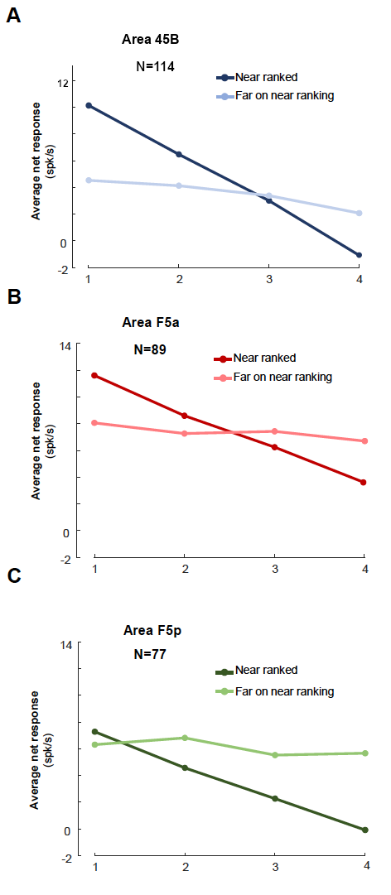
Object selectivity is not preserved across near & far viewing conditions
Object Rank
Notes:
Figure 6
Note the lower responses relative to the typical far responses in F5p, supporting their overall hypothesis
And the larger number of greater near responses in 45B
and F5a lying in between

Slide 21
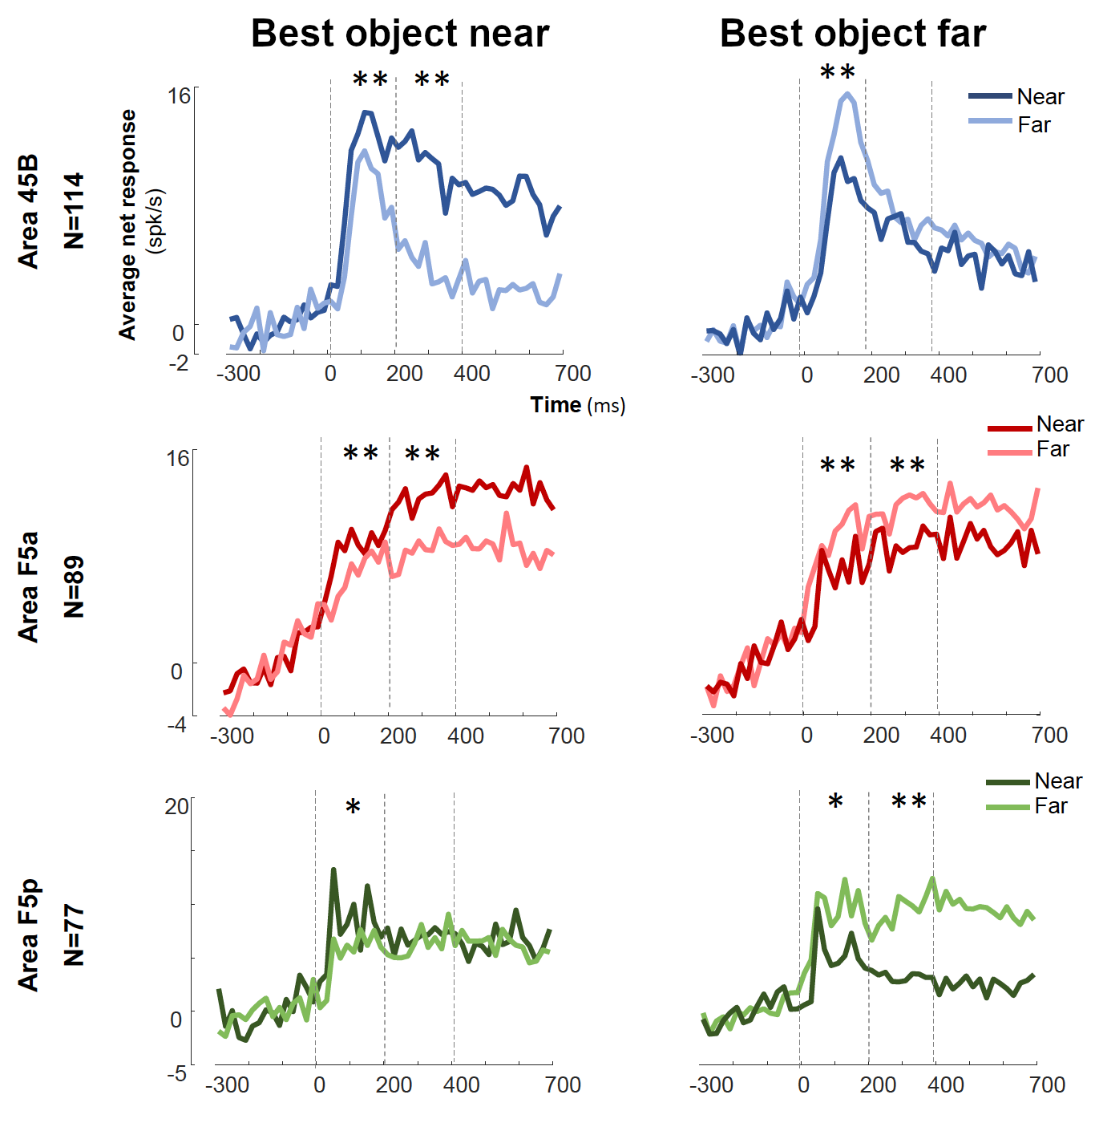
Object selectivity is shifted, rather than nonexistent, in the “far” condition
Notes:
Figure 7
Does this actually tell us anything Figure 6 didn’t?
I guess it works in reverse and shows that preferred objects in the far condition DO exist in F5p, rather than the underlying effect being one of no object preference, but overall increased rate, in the “far” condition among these neurons
And indeed it shows that there is “far” selectivity that is present. It just doesn’t match the “near” selectivity.

Slide 22
Retinal size explains most of these effects
Notes:
Figure 8
So one thing that could be going on is that object selectivity is being dictated by retinal size rather than near/far per se. Indeed, only the fMRI study mentioned so far bothered to correct for that.
And indeed, this panel shows responses to be consistent between near/far conditions when the object is grown/shrunk to occupy consistent retinal area.
They still technically see a significant difference in the late epochs for 45B and F5a, the more “visual” areas according to them. But, like, come on. Those effects are quite small, and that most effects are eroded upon doing this control suggests that the extra/intrapersonal distance effect is actually quite tiny!
And before you ask, the analysis they run on which areas have which preferences occurs BEFORE they do their control for retinal size. Rather than running this control and THEN characterizing distributions of near/far preference, they go in reverse: first characterize near/far preference, THEN run the control to say “look the effect is still there (but super tiny)!”
So… is anything in this paper worth talking about???

Slide 23
Responses during visually-guided grasping
“Light on”

Slide 24
Responses during memory-guided grasping
“Light off”
Notes:
First part of Figure 9, where we have a memory-guided grasp like our own
They contrast this with a visually-guided grasp (where the light stays on after the go cue) and…

Slide 25
“Early-to-late” response gradient
Light on
Light off
Notes:
…the second part of Figure 9, showing each area’s averaged PSTH to each neuron’s best object.
No error bars, by the way.
But the point they’re trying to make is that F5p comes online later (with vision actually seeming to suppress response during movement), 45B comes online earlier & decays throughout the grasp (faster decay without vision), and F5a is somewhere in between (ramps up upon seeing object, holds steady throughout the task)
one thing to notice is that response properties are exaggerated during memory-guided than during visually-guided grasps
The opposite of what Stefan noted in his own data in AIP

Slide 26
“Early-to-late” response gradient
Notes:
And here’s table 4 showing the timing of significantly supra-baseline responses in each area
The idea being that both 45B and F5a are active throughout the trial, but F5p is preferentially active during peri-movement epochs
Supporting the broader notion of a visuo-motor gradient within the frontal cortices
(Despite the counterintuitive near-to-far gradient in their visual responses)
They aren’t super specific about what exactly these numbers mean, though. Number of “significantly active” ones? Based on what criterion? (e.g., alpha = 0.01?)
IMPORTANT NOTE: older literature on this stuff suggests the lift & pull selectivity may actually be somatosensory in nature? Rizzolatti’s classic papers (as in, pre-mirror-neuron classic papers) note that, particularly in post-arcuate areas, one sees loads of somatosensory responses. So this could just as easily be a “touch” effect as it is a “motor” effect (to the extent there is a massive difference between F5a and F5p, that is)
Note: although fewer F5p neurons are active during the “go cue” period

Slide 27
Recall: object selectivity during fixation
Notes:
45B (N = 114), F5a (N = 89) and F5p (N = 77)
Numbers for each monkey, in order of 45B / F5a / F5p:
Monkey 1: 57 / 45 / 44
Monkey 2: 57 / 44 / 33
These are all based on significant terms in each neuron’s ANOVA (alpha = ???)

Slide 28
Re-assessed conclusions
Mixture of near-far preferences in peri-arcuate cortex
Near-far gradients are subtle, mostly explained by retinal size
Rostro-caudal visuo-motor gradient consistent with expectations
Rostral 45B has more visual object selectivity
Caudal F5p is more selectively active during movement
Notes:
Ultimately, I don’t think we learned anything new.
The only things I trust are the affirmations of old ideas.
It does place a spotlight on area 45B, which is an interesting area to say the least, although its potential homology with human speech centers makes you wonder if its relationship to limb movements in macaques reveals a boundary beyond which macaques are no longer a good model organism.
And it does place a spotlight on the idea of a difference between anterior & posterior F5 in terms of the balance of visual & motor properties of their responses, which seems legit.
The novel finding (the reversed near-far preference gradient) I am extremely skeptical about. They’d need to fix their analysis to convince me of that.

Slide 29
Refinement needed!
Assess near-far preference after correcting for retinal size
Count neurons with near-far preference using a significance criterion
Block “near with grasp” and “near without grasp” trials
Notes:
Speaking of fixing their analysis, here is what those fixes might look like (and one experimental fix I think would be needed)

Slide 30
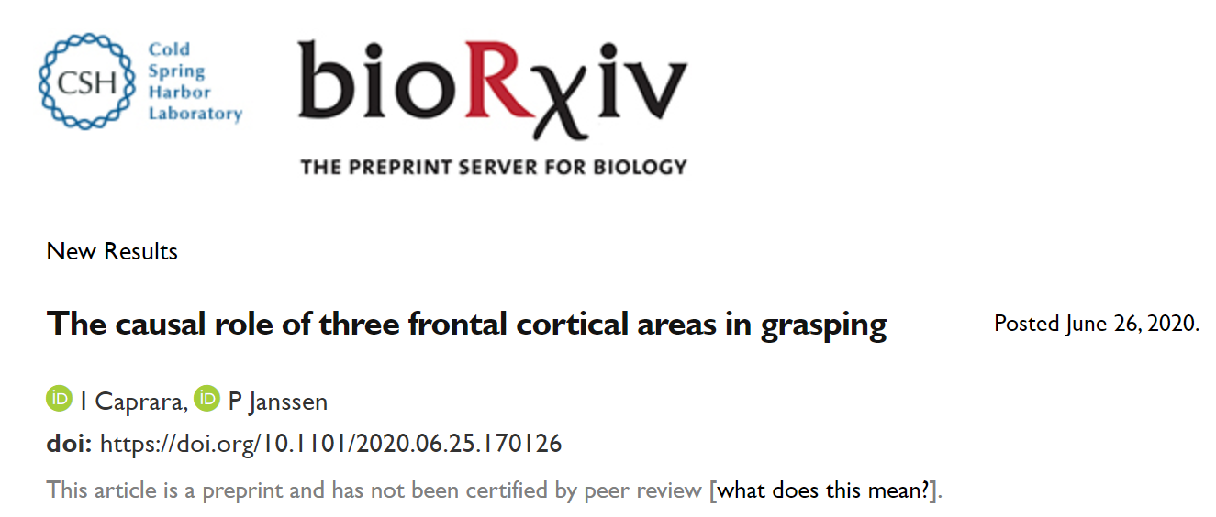
Related inactivation study posted last week
Notes:
And I just wanted to let y’all know that this is just one of a few papers in the Caprara-Janssen pipeline, with another (which JUST got posted last week) being a reversible inactivation study with muscimol looking to further affirm the presence of a visuomotor gradient within frontal cortical areas
Another warning though: this, too, is pretty old-school

Slide 31
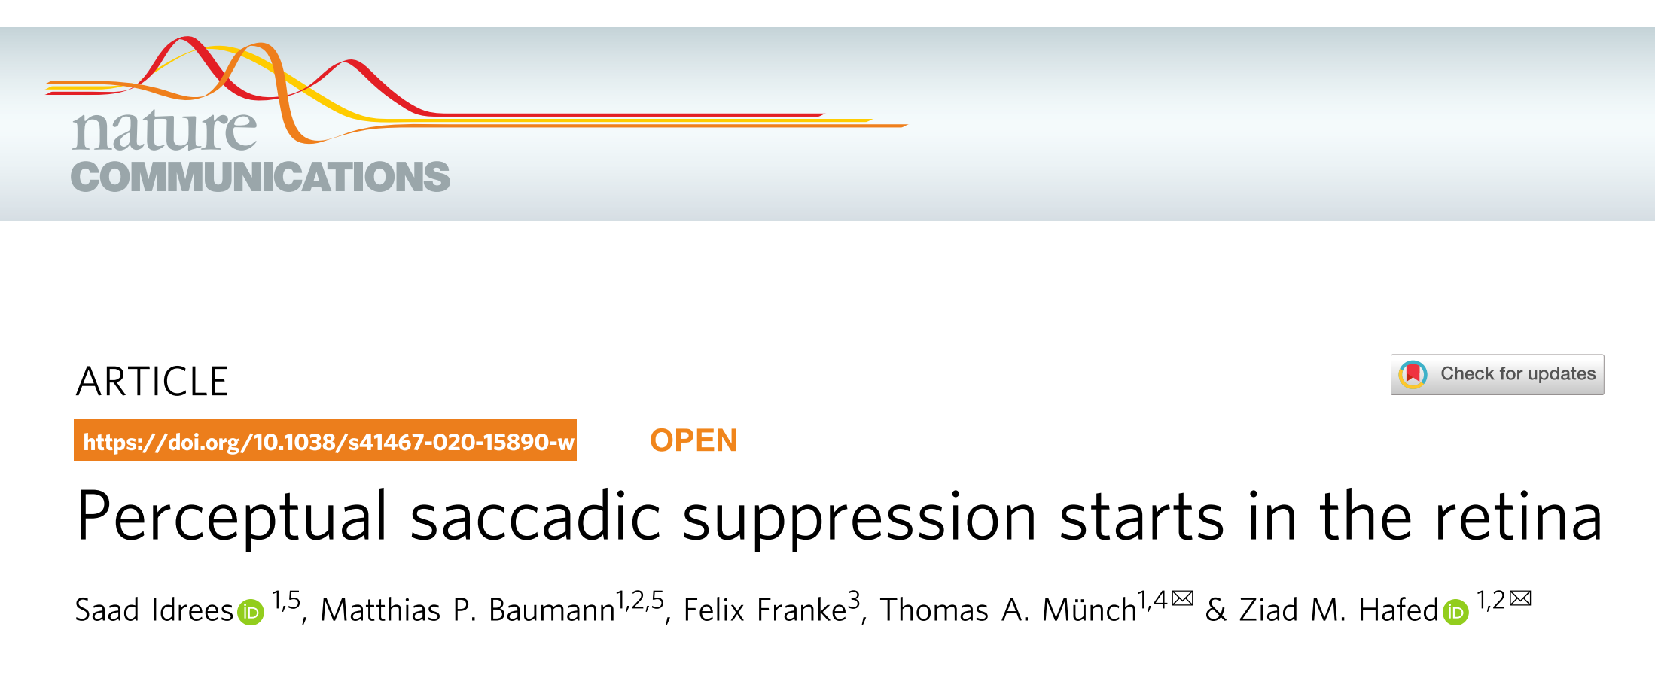
The “exciting” paper I was considering
Notes:
And in case you think I’m a fuddy-duddy, this is the “new-school” paper I was considering doing. It’s pretty great in my opinion, it tears down the notion that saccadic suppression is necessarily some central process for stabilizing visual perception, instead noting that all suppression effects arise because the retina simply gets overloaded and “drops frames” during visual input arising from hyperfast saccade movements. By elimination the notion that central input has to be suppressing responses, it tears down the one example of a classic, stupid-simple “blanket suppression during movement” computation that one could point to. Internal models and attention are king!

